Slide 1
CSS430 Introduction Textbook Chapter 1
Instructor: Prof. Dimpsey
e-mail: dimpsey@uw.edu

Slide 2
Breakout!
Test your audio / Video

Slide 3
Intro: Who am I?
Studied at University of Illinois: BS, MS, PhD (CS, CE, EE)
Worked at IBM and Microsoft on a bunch of stuff including:
Operating Systems
Java Virtual Machines
Business Platforms: WebSphere, BizTalk
Dev Tools: Visual Studio
Frameworks: .Net, Windows Communication Foundation, Workflow
Azure Cloud Services
Cloud Commerce Services
Supply Chain
Operating Systems I’ve worked on
AIX
Microkernel
Linux
OS/2 and WARP
Taught at UT and UWB: CSS332, CSS340, CSS342, CSS343, CSS430, CSS432, CSS436, CSS501, CSS502, CSS503, CSS490 (Cloud), CSS566

Slide 4
Course Objectives: Why are you here?
Understand fundamental concepts of operating systems
Critical to understand how underlying system
Core knowledge underpinning CS
Enhance system design skills
Introduce Multi-threaded programming
Enjoy yourself and become a better person!

Slide 5
Topics
OS / Computer background
Processes
Threads
CPU Scheduling
Synchronization
Memory Management
Main
Virtual
File Systems
Deadlocks

Slide 6
Logistics
Email: dimpsey@uw.edu
We will use Canvas for
Announcements
Assignments
Grades
Discussions
Textbook: Operating System Concepts, Silberschatz, Tenth Edition
On-line Edition, OR
Print Edition
Should you read this book: YES!

Slide 7
Syllabus
Five Minute to read Syllabus
Draft form
I can still make changes and it will change through the quarter
Send all proposed updates this week
Breakout!
Determine one Syllabus question
Syllabus Highlights

Slide 8
Office Hours
ZOOM: MW 10am - 11am

Slide 9
Assignments / Tests
Programming Assignments
Programs: 5 - 6
Exams
Midterm
Final
Home Work
Homework (mainly problems from book)
In-Class Assignments

Slide 10
Grades
40% Tests
Midterm: 20%
Final: 20%
50% Programs
Individual and group
10% Homeworks / Assignments
In-Class and Take-home
Individual and group

Slide 11
Program Assignment Grading
Program Grading
Design
Style
Correctness
Efficiency
Program grading will be done by
Design Inspection
Code Inspection
Black Box Testing of created services

Slide 12
What is an Operating System?
Goals
Execute user programs
Making the computer system convenient to use
Use computer hardware efficiently
Blurred lines as to what is in the OS
Famous example: 1998 MS browser
Dennis Ritchie (Unix) definition
Kernel
Shell
Core set of Applications (editor, etc…)
https://www.youtube.com/watch?v=JoVQTPbD6UY

Slide 13
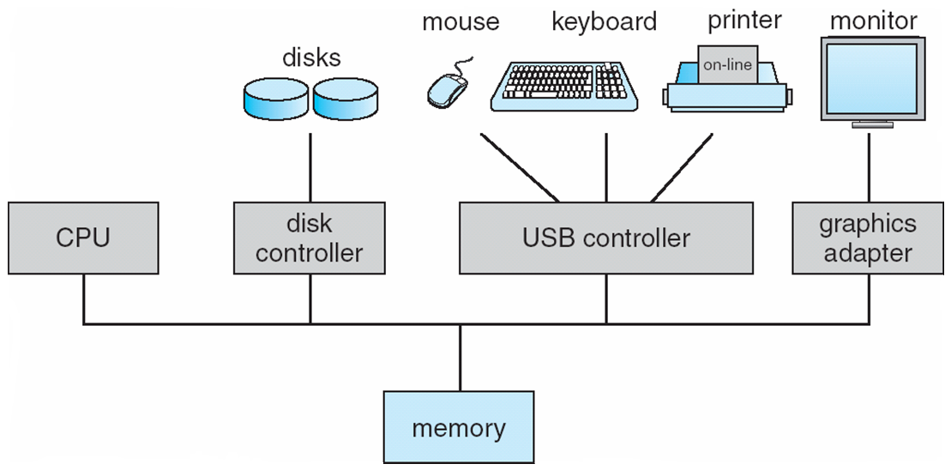
Computer Hardware

Slide 14
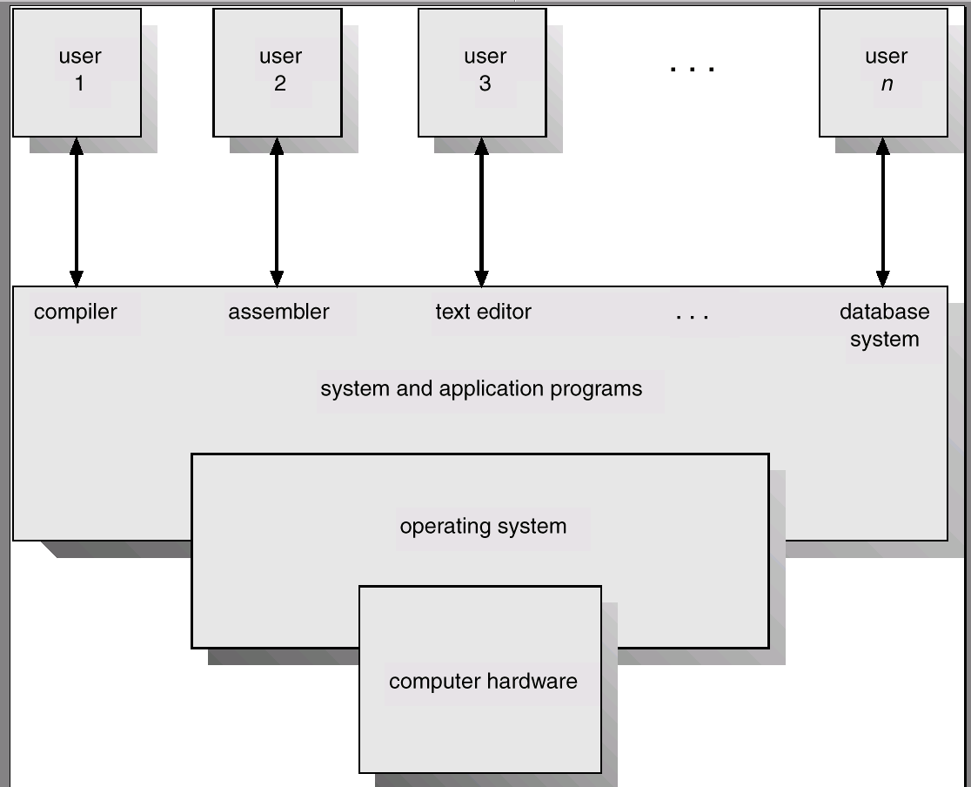
Computer System Components

Slide 15
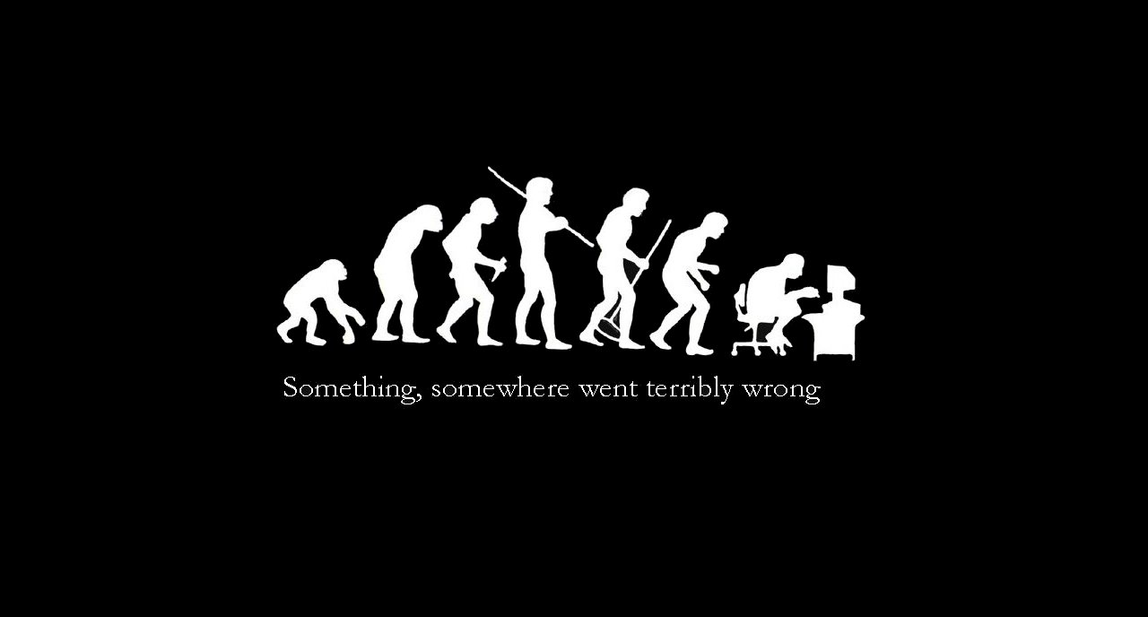
Some Operating System History….

Slide 16
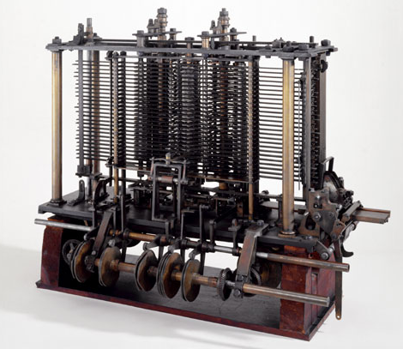
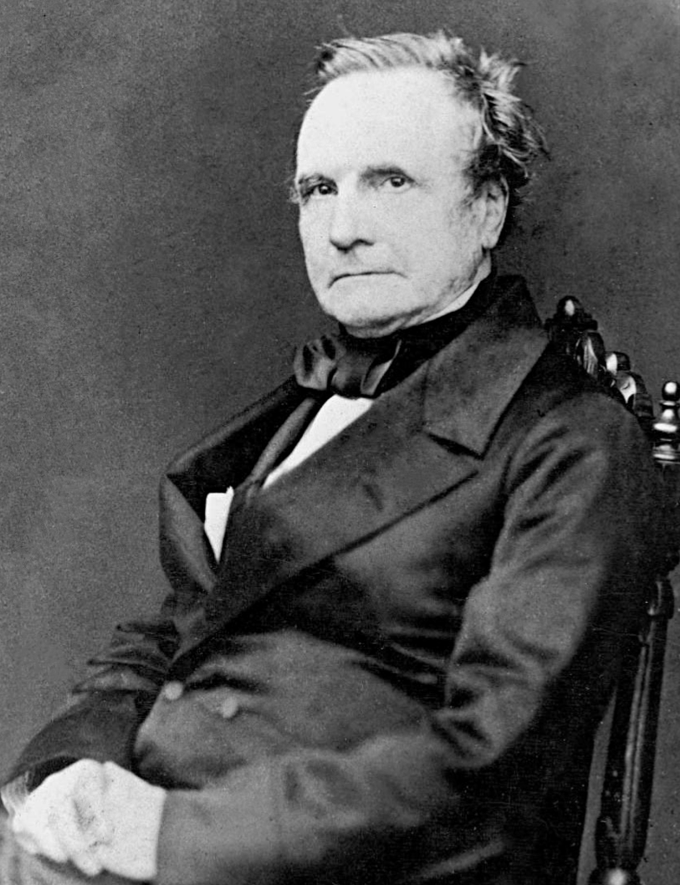
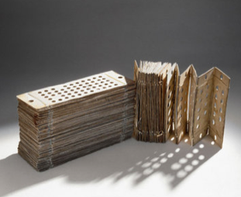
Charles Babbage (1792-1871)
Analytical Engine
Punch Cards
Ada Lovelace the world’s first programmer!

Slide 17
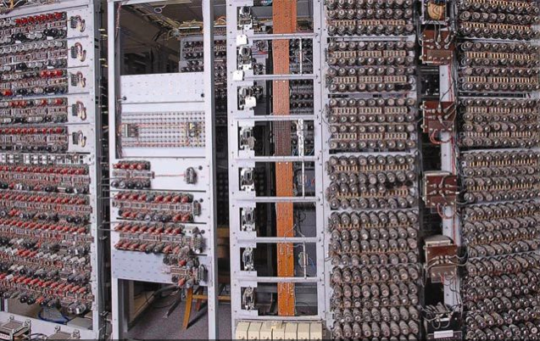
Colossus
1944 Colossus: first programmable, electronic, digital computer
Developed by British Codebreakers (Turing contributed)
Bombe used to help decode Enigma (German code)

Slide 18

ENIAC
1946 ENIAC : Stored Program
US army supported general purpose electronic computer to calculate artillery firing tables.
Presper Eckert and John Mauchley main developers.
Led to EDVAC and Univac.

Slide 19
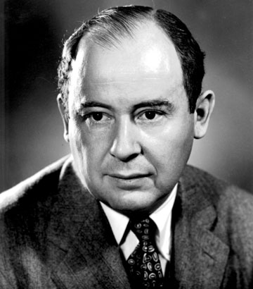
Computer Scientist of the week
John Von Neumann!
Innovations in Set theory, Geometry, Quantum Mechanics, Economics, Statistics
Founded Game Theory
Monte Carlo Method
EDVAC: data and program both in same address space
ENIAC: First computer to use a stored program
Von Neumann Architecture!
Manhattan Project
MAD: Mutually Assured Destruction
Merge Sort Algorithm

Slide 20
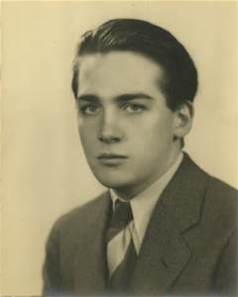
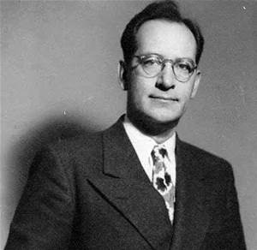
Who really developed the Von Neumann arch?

Slide 21
Breakout!
What is the Von Neumann Bottleneck?
What has been done to alleviate this issue?
Enjoy this video : https://www.youtube.com/watch?v=IJN4Ah4QDpg&t=8s

Slide 22
Class Bell
1.05.2021

Slide 23
Announcements/Agenda
ANNOUNCEMENTS
RECALL: Required readings on first slide of deck
Von Neumann Arch Video: https://www.youtube.com/watch?v=IJN4Ah4QDpg&t=8s
Homework 1: 1/12
Program 1: 1/20
Quantitative Skills Center (QSC): https://www.uwb.edu/qsc
AGENDA
Finish OS History
System Calls
FORK

Slide 24
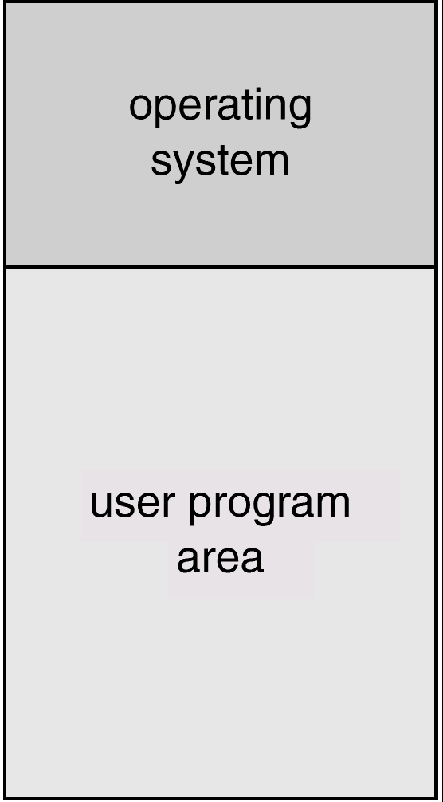
Batch Systems
A job is assembled of the program, the data, and some control information (in control cards).
Programmers pass their jobs to an operator.
The operator batches together jobs.
OS transfers control from one job to another.
Each job output is sent back to the programmer.
Program has control over all of the system resources
memory

Slide 25
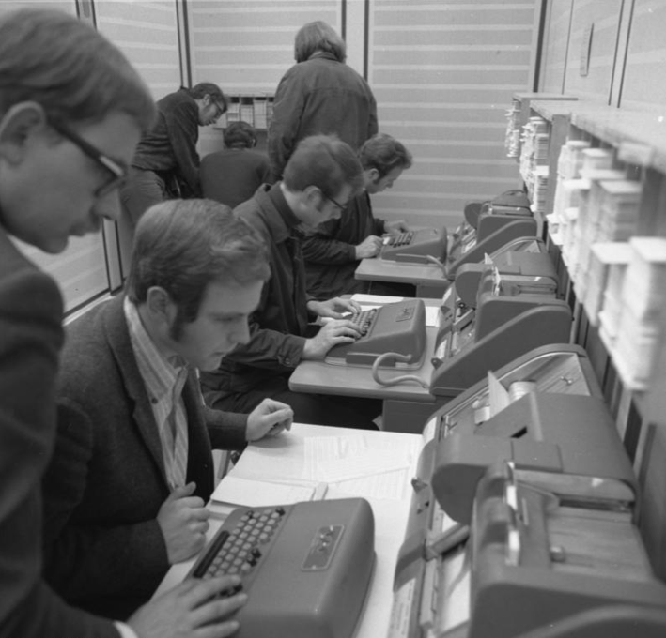
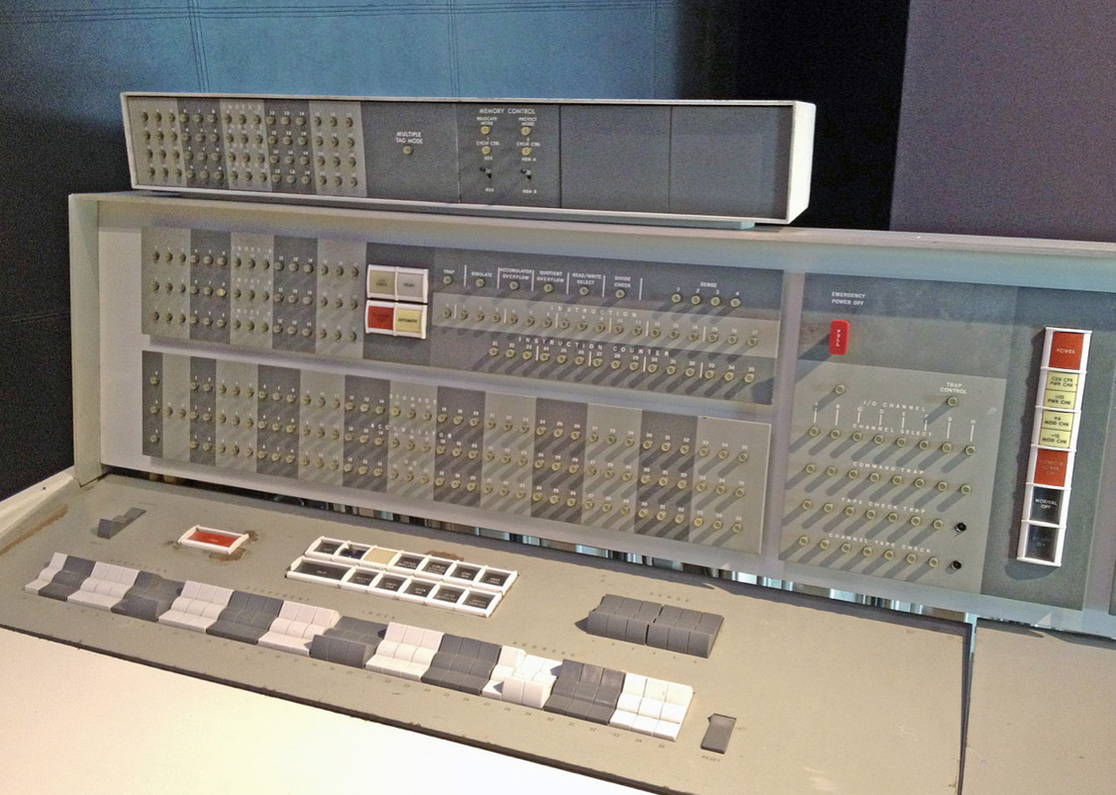
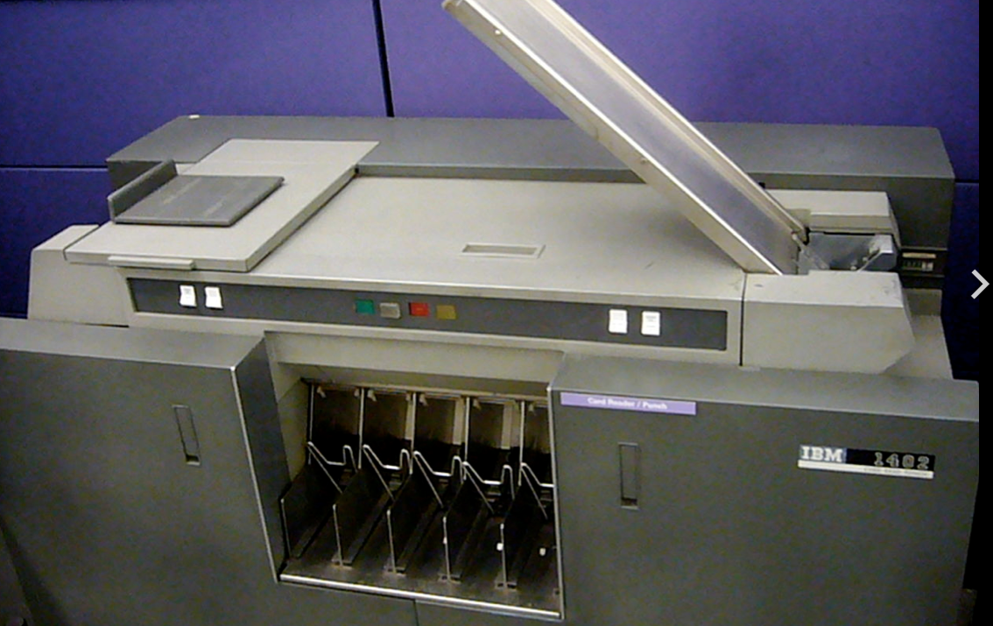
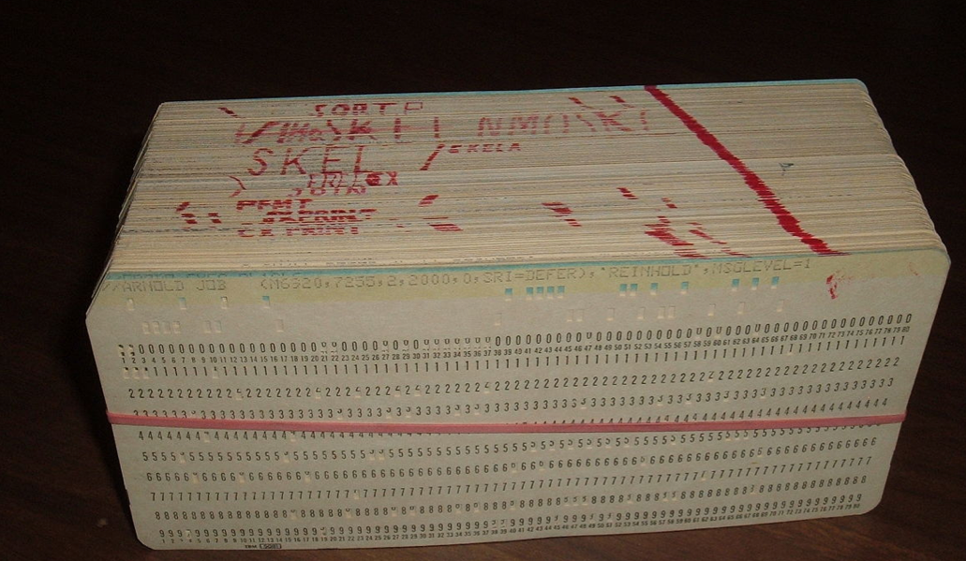
FORTRAN PUNCH CARDS
CS in the 1950/60s!
IBM 7094 – IBMSYS OS
Punch card reader
SINGLE PROGRAM Software

Slide 26
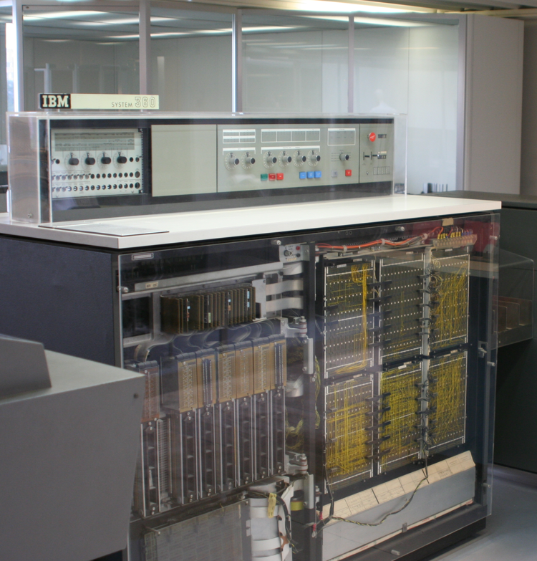
3rd Generation -IBM 360 – OS/360
Announced in 1964*
A fundamental leap in the history of computing/OS
Created to unify instruction sets of all IBM systems
This aspect did not quite work as people did not want to port apps
Introduced virtualization
Millions of assembly LOC
Thousands of programmers
Multiprogramming!
*Greatest year of the 20th century

Slide 27
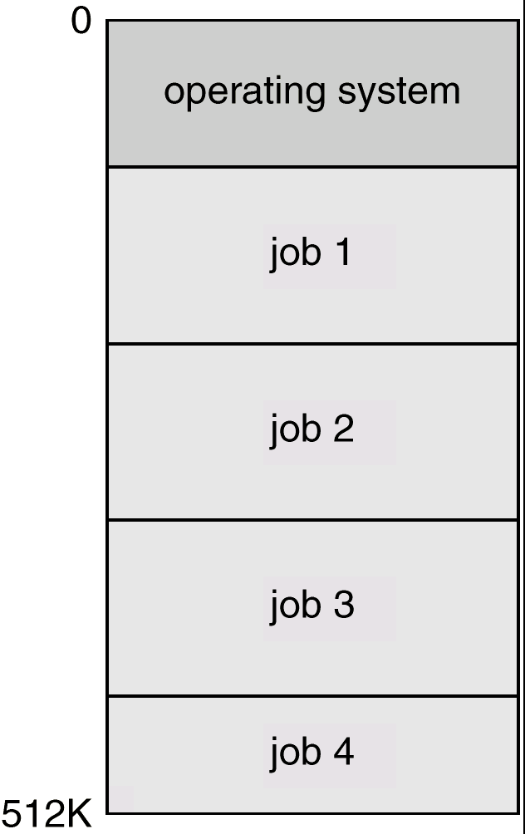
Multiprogramming
Several jobs are kept in main memory at the same time.
OS picks one of them to execute.
The job may have to wait for a slow I/O operation to complete.
OS switches to and executes another job.
To facilitate multiprogramming, OS requires:
Job scheduling
Memory management
memory

Slide 28
Time-Sharing Systems
This is a logical extension of multiprogramming.
Each user has at least one separate program in memory.
A program in execution is referred to as a process.
Process switch occur so frequently that the users can interact with each program while it is running.
File system allows users to access data and program interactively.

Slide 29
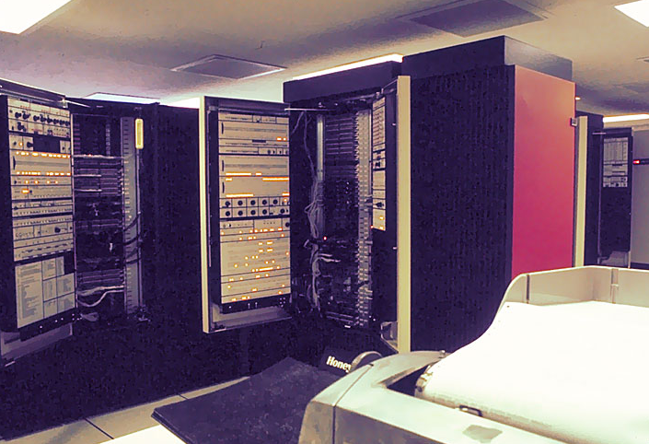
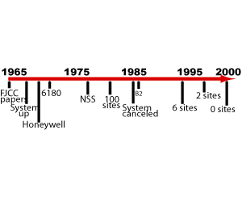
Multics
Multiplexed Information and Computing Service
Conceived as a general purpose time-sharing utility
Joint project of MIT, GE and Bell Labs started in 1965
Taken over by Honeywell in 1970
MIT shut down its Multics system in 1988
Last system was deactivated in 2000
Precursor to Unix

Slide 30
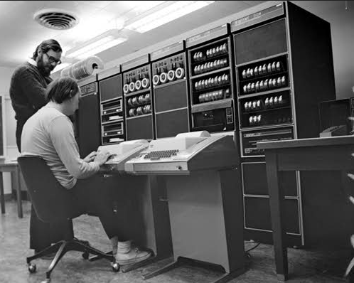
Unix
1969: Ken Thompson and Dennis Ritchie
Bell Labs on a $70,000 DEC PDP-7
Developing an alternative to Multics
Focusing on doing a single thing: Uni(x)
Long and strong history
Unix
BSD Unix (1977)
System V Unix
HPUX, AIX, Solaris, ..
Current Mac OS are Unix based
Linux

Slide 31
Breakout!
There are two main categories of operating systems available in the world: Open Source and Closed Source
Give examples of each type of OS
List Pros/Cons of each

Slide 32
Open Source Operating Systems
Open Source
Software Industry started in an Open Source culture (~1950s)
“Homebrew Clubs” and MITs Model Railroad Club source code
Copyright vs. Copyleft
Binary only releases and source code copyrights (closed source)
Digital Rights Management (DRM) - illegal to reverse engineer
Free Software Foundation (FSF): https://www.fsf.org/about/
GNU project (“GNU’s Not Unix”)
http://www.gnu.org/gwm/libredocxml/x53.html
GPL – General Public License – must ship source with binaries
GNU license which is also copyleft
GNU/Linux
Hundreds of unique distributions from the core…
https://www.kernel.org/pub/linux/kernel/v2.6/

Slide 33
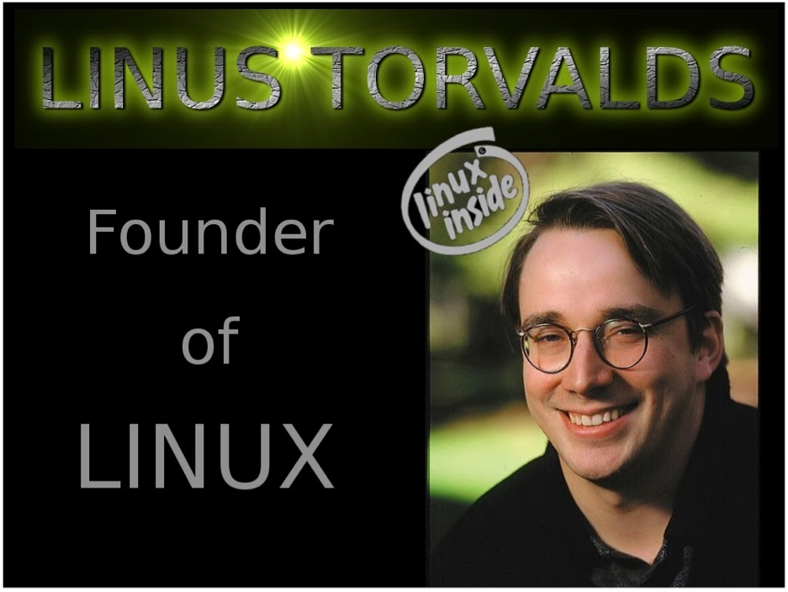

Linux
- Started with MINIX3 for education (Tanenbaum)
http://www.minix3.org/documentation/index.html
4 Major Open Source OS Distributions:
Red Hat / Fedora/Centos – (Redhat $s, Fedora/Centos – FREE)
SUSE/OpenSUSE - Enterprise FREE
Debian – Popular on small Linux platforms (e.g. Raspberry PI)
Ubuntu – (e.g. Our UW Bothell Lab OS!)

Slide 34
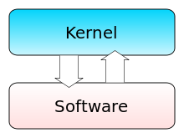
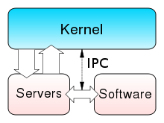
Tannenbaum-Tovalds Debate
Microkernel v. Monolithic kernel
1992 on-line debate between Tannenbaum and Torvalds
“Linux is Obsolete” – Tannenbaum
Key Points:
Linux, Unix monolithic and outdated
Non-portable
Brittle
Open-source issues

Slide 35
Linux Lab Orientation
Hands-On Demo

Slide 36
Linux Access
Dual boot Linux on your laptop (https://www.ubuntu.com/download)
Get a Linux VM from Amazon or Azure
Utilize Linux UW1 Lab In-Person
NOT THIS QUARTER! But, wanted to let you know.
Go to room uw1-320; you should have access
Login / Tutor help available
Utilize Remote Linux Lab
https://www.uwb.edu/css/facilities/linux
http://depts.washington.edu/cssuwb/wiki/connecting_to_the_linux_lab
https://itconnect.uw.edu/connect/uw-networks/about-husky-onnet/use-husky-onnet/
Run virtual Linux environment on your laptop
Multiple versions of this but perf/fidelity can be poor
http://www.vmware.com/download/player
Generally least preferred

Slide 37
Remote Linux Lab Demo
Linux Lab
Host Names: csslab1@uwb.edu – csslab12@uwb.edu
Share NFS backed file system
Access from MAC / Linux
ssh uwnetid@csslab1.uwb.edu
Requires HuskyNet when off-campus
Access from Windows
PUTTY
MobaXTERM (https://mobaxterm.mobatek.net/)

Slide 38
Linux Access: Check out the Video!
HERE: https://youtu.be/Y2BgH_pZObo
CLICK LIKE AND SUBSCRIBE ☺

Slide 39
Linux Lab: tips to improve your life ☺!
TASK | DESCRIPTION
Servers | csslab1 – csslab12 : 12 Ubuntu x86-64bit Machines 00-12 connected to 1000Mbps network
Login | $ ssh uwnetid@csslab1.uwb.edu (machine 1)
Goto my home | $ cd ~mynetid
Transferring Files→ UWB | $ scp foo.tgz uwnetid@csslab7.uwb.edu:
Transferring UWB→local | $ scp uwnetid@csslab6.uwb.edu:bar.tgz .

Slide 40
Basic Commands: (Brackets:<> means required, [] means optional)
cd <dir name> | Change directory
mkdir <dir name> rmdir <dir name> | Make directory Remove directory (get in the habit of using this)
ls ls –l ls -al | Basic listing of the current directory Listing in list format with more details Listing in list format with all details
mv <source> <dest> | Move files and/or entire directories
rm rm –r rm -rf | Remove a file Remove a full path (VERY DANGEROUS–USE WITH CARE) FORCED recursive remove (EVEN MORE DANGEROUS!!)
cp <source> <dest> cp –r <source> <dest> | Copy files Copy files recursively (for full multilevel folder cp)
man <command name> | Unix manual for a given command
chmod <permissions> <filename> | Changes permissions on a file or directory Ex. $chmod 700 <directory> - readable only by owner $chmod –R 755 <directory> - sets contents readable and writable by anyone
~mynetid . .. | Shortcut name for your home directory Shortcut name for the current directory Shortcut name for the parent folder above

Slide 41
Editors/Compilers
NAME | DESCRIPTION
pico | Simple file.txt oriented editor
Vim | (or vi) the most widely used editor in the Unix world
Emacs | Hardcore programmer editor – very powerful in the right hands
Notepad++ | Great editor on Windows platform
Textmate | Great editor on Mac platform, but check out …
Sublime | Cross platform beautiful code editor – many plugins
gedit | Editor I will use in class
Compiling | gcc filename.c → successful compile/link to ➔ a.out gcc filename.c –o filename → compiles to ➔ filename g++ filename.cpp → successful compile/link to ➔ a.out g++ filename.cpp –o filename → compile/link to ➔ filename javac Classname.java → Classname.class
Running | $ ./a.out $ ./filename $ java Classname

Slide 42
IDEs
NAME | DISCRIPTION
Netbeans | Free IDE from Sun/Oracle – great, easy to use Java IDE
Eclipse | Most popular Open Source IDE – takes some time adapting, terse
Visual Studio | Very powerful IDE for C/C++/C#
IntelliJ IDEA | Industrial Strength Cross Platform/Cross Language IDE – large plugin ecosystem. Will use this in class
Xcode | Mac OSX IDE (mainly) for Objective-C, Java possible
CLion | C and C++ IDE (https://www.jetbrains.com/clion/)

Slide 43
In Class Demo…let’s build together
C++ HelloWorld on Linux
Java HelloWorld on Linux

Slide 44
FIFTY-STEPS
Great set of Linux Exercises: https://depts.washington.edu/cssuwb/edit/50-step-unix

Slide 45
PC

Slide 46
Personal-Computer Systems: MAC/PC
PCs: Computer system dedicated to a single user.
PC OS’s went through similar evolution as larger computers
Initially, single user system, so did not require advanced CPU utilization, protection, multiprogramming, etc..
Multiprogramming added
File protections and security
Multi-user support
The same OS concepts are appropriate for all the various different classes of computers

Slide 47
Personal Computers (1980 - now)
CP/M (Control Program for Microcomputers)
MS-DOS and the IBM PC (OS2)
MAC OS, MAC OSX
Windows, Windows NT, Windows 8, Windows 10
Linux (Multiple Distros e.g. RedHat, Suse, Debian, Ubuntu)

Slide 48
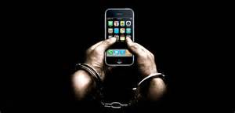
Mobile (1990 - now)
DEVICES!!
Phones
Tablets
Originally termed PDAs – Personal Digital Assistants
Operating Systems for Smart Phones
Google Android (Linux Based)
Apple iOS
Symbian OS (Nokia, now owned by Microsoft)
RIM’s Blackberry OS
Windows Phone
Unique Operating System Challenges
Size
Power
Internet of Things (IOT)

Slide 49
Cloud

Slide 50
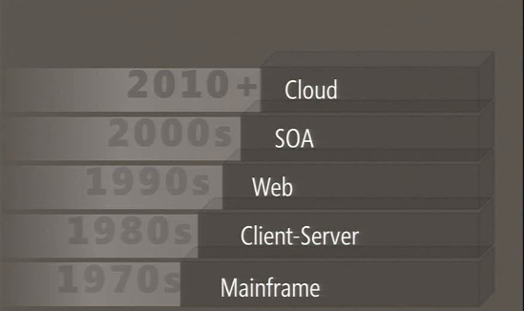
Evolution of Server Computing

Slide 51
Cloud
Centralized compute managed by others
Drives down maintenance cost for user
Reduces IT department
Improves reliability
Economy of scale
Made possible by
Internet
SOA
Virtualization
Advances in large scale HW
Key players: Amazon, Microsoft (Azure), Google, IBM
Battle of eco-systems
Devices/Services

Slide 52
Cloud taxonomy
IAAS: Infrastructure as a Service
VMs
DB instances
PaaS: Platform as a Service
BLOB/Table Storage
SQL Azure
Hosted web services
Schedulers
SaaS: Software as a Service
Office Products in the cloud
Google Apps
ITunes
App Stores

Slide 53
Virtualization
Multiple OS images sharing same hardware
Possible as HW power/memory increases
VMWare, Hyper-V, IBM Mainframes
Initially embraced by enterprises for resource sharing of expensive centralized computing
One large server
Services many users in a “fully” isolated manner
Currently used by developers to have many images to work with
Checkpoint work
Share full environments
Alpha/Beta products
Key enabling technology for cloud

Slide 54
Containers
Virtualization in or on-top of OS
Used to create full development environments
Snapshot full set of apps/environments
Inexpensive way to share environments with developers
Also used for micro-services
Docker/LXC is a key example
Supported by all major cloud providers: AWS, Azure

Slide 55
In Class Demo
Grab a VM from Azure or Amazon

Slide 56
In Class Assignment
What is the difference between a container and VM ?
What are the use cases for each; advantages of each

